Slide 1

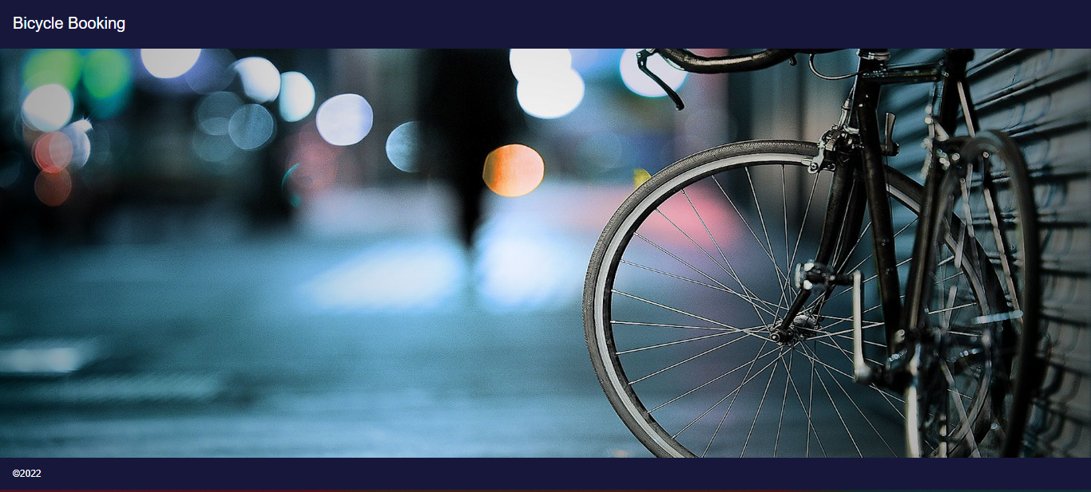
Bicycle Rental App
Team :
K.Bhavana
P.Chandana
K.Ravi Teja Reddy
Dhansree Mul

Slide 2
Outline
Problem Statement
Objective
Project Overview
Architecture
Project Flow
Technology and Tools Used
Conclusion

Slide 3

Problem Statement
A Person is a enthusiast on riding bicycle but worried about buying a bicycle due to lack of money.
A Person wants to ride a bicycle without buying it.

Slide 4
Objective
Our objective is to provide best user experience to X so that X can book a bicycle and ride with the low cost.

Slide 5
Project Overview
Name
Add Booking
Cost
Web API
REST API
Authentication API
Sign In
Category
Descrption
Admin
login
Update
Sign Up
Booking Report
Home
Delete
BiCycle Bookings
user
Category
Date
Time
BiCycle Details
Name
Delete
MySql
MySql
MySql

Slide 6

Project Flow
Home
Create
Modify
User Login
Register
Admin Login
Update
Delete
Add booking
Booking details
Recommends
Name
Charge
category
Time
Update
Modify
Search Books

Slide 7
Architecture
Authentication API
MYSQL
Login/Register
POST request
Token generated
Front End
Angular
POST /GET/
DELETE
REST API
MYSQL
GET/DELETE
UPDATE
Search Bicycle
Web API
GET
GET

Slide 8







Technologies and Tools Used

Slide 9
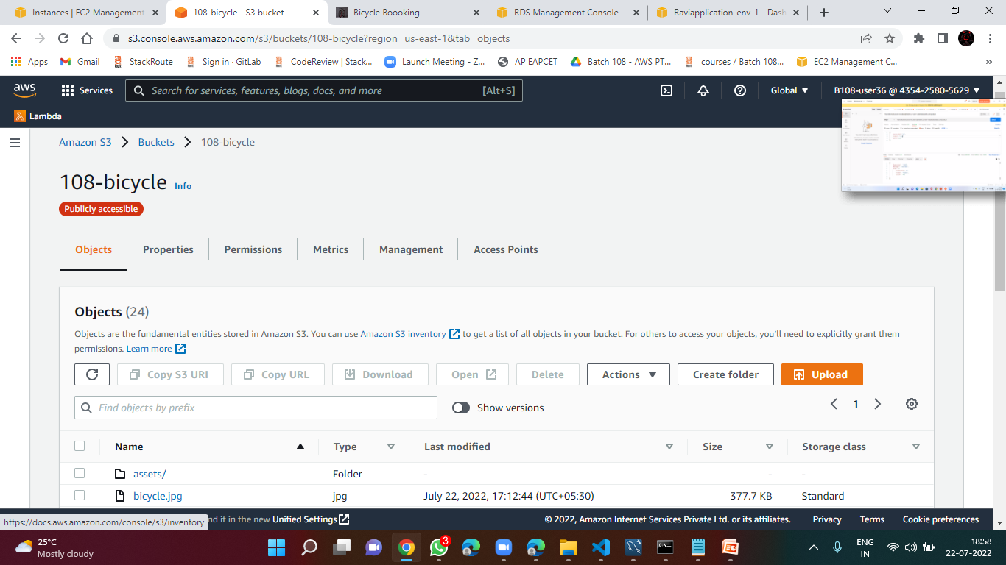

Slide 10
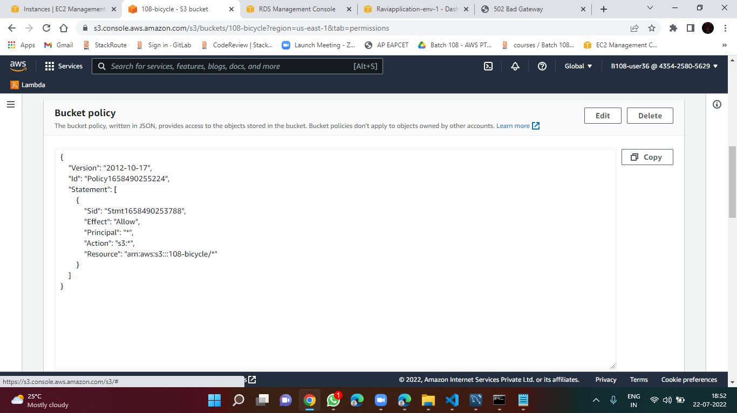

Slide 11
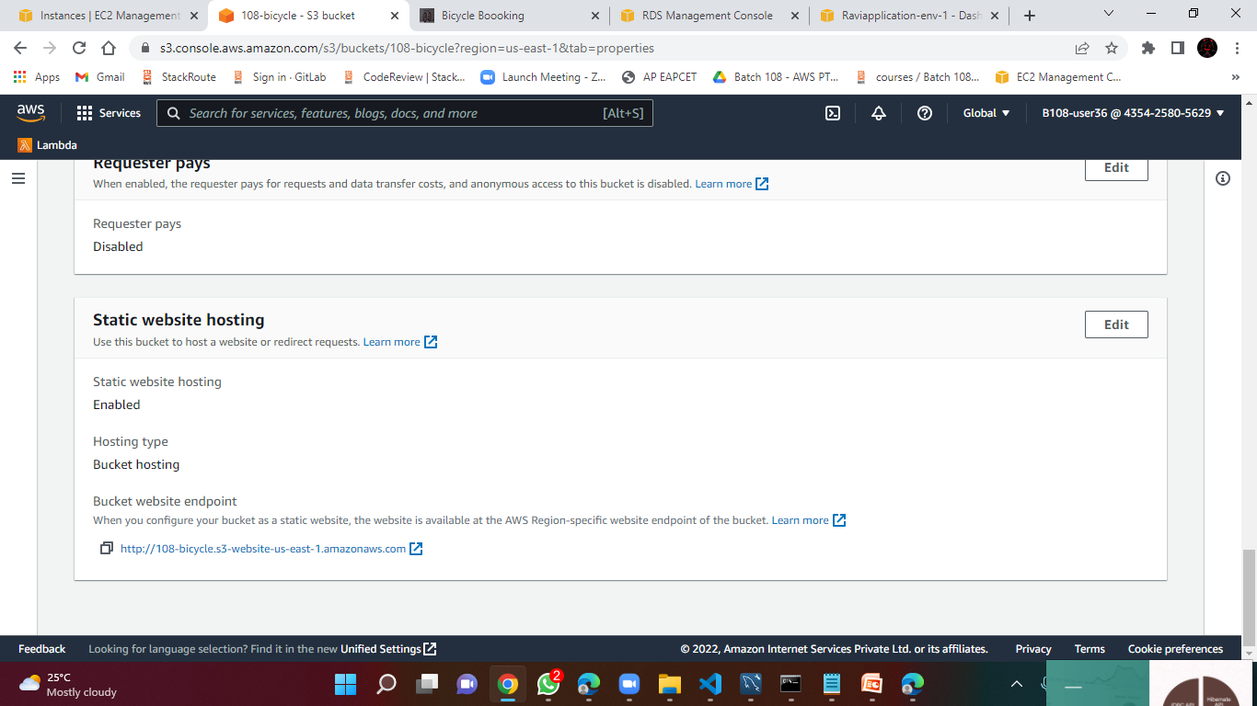

Slide 12
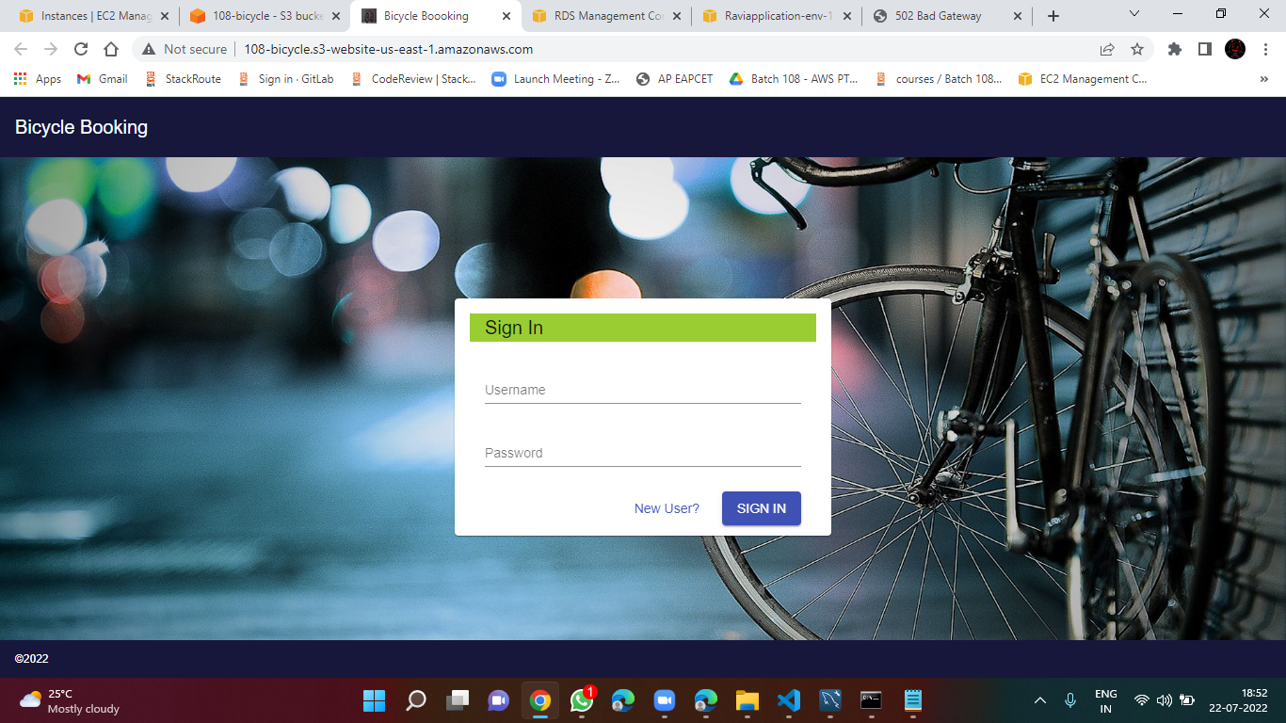

Slide 13
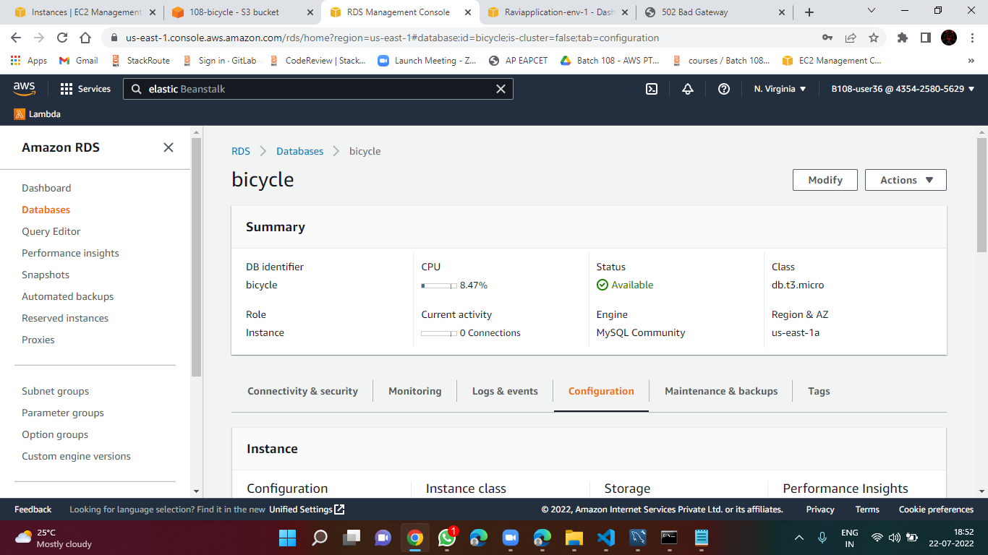

Slide 14
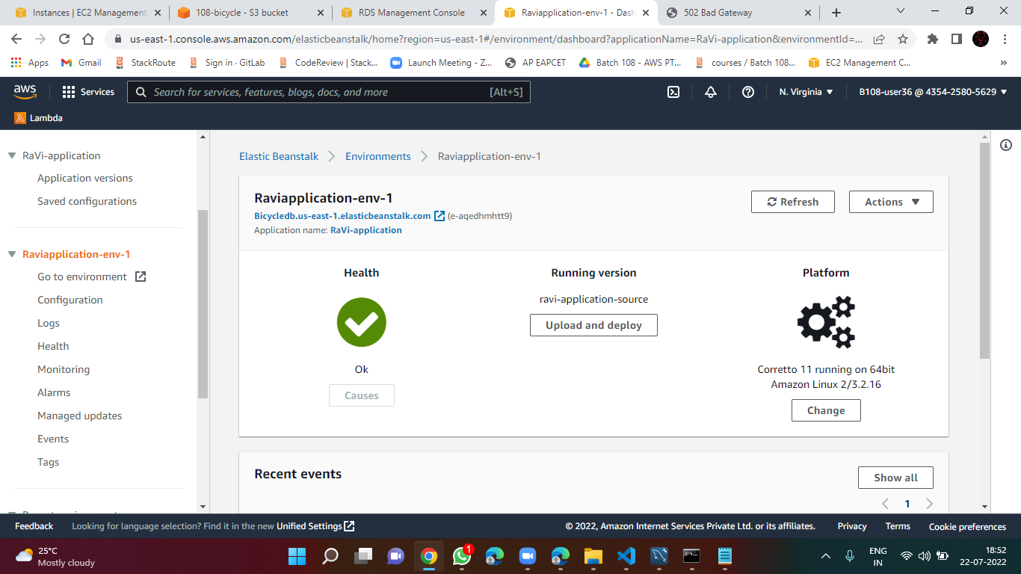

Slide 15
Conclusion
The Bicycle Rental app helps the user to rent for bicycles through online. It also helps user to ride their favourite bicycles and after using it delete them afterwards.

Slide 16
Thank You

